Slide 1
Transition in the automotive industry - Hungary Electrification Hydrogen

Slide 2
State strategy
Establishing a local market is not realistic
Support of OEMs (MBMH, BMW, Audi) – expensive, not transparent, market distorter
What left: join the supply chain: National battery strategy
Diversification: Hydrogen strategy

Slide 3
Company strategies
Currently traditional, hybrid and electric are present at the same time → labour shortage
Automatization where possible, plus foreign workforce (mainly in the supply chain)
Moving toward skilled and highly educated workforce (problems with education system)
Growing and expansion (new areas) of production

Slide 4
Trade unions
Strong at OEMs
No influence on strategic decisions (even local management often doesn’t have a word, only lobbying)
New organizing strategies (foreigners, white collars, etc.), as the traditional base is shrinking
Slowly changing priorities of members: wages → working conditions → OHS → environment protection

Slide 5
Summary
Externally controlled
Hungary’s situation is fairly good (OEMs)
Government’s priority is the level of employment; innovation, modernization is not
Companies aiming to increase added value
Suppliers are in a vulnarable situation
Trade unions need to adapt

Slide 6
Electrification - Batteries
National Battery Industry Strategy 2030
Aiming to become the central of European battery value chain and 2nd in the world
Socially, economically and environmentally sustainable battery industry
Main projects:
1. Recycling facilities
2. Lithium from thermal water
3. Batteries to control the energy market (batteries next to fields of solar panels)
4. Electromobility
5. R+D+I projects
Cooperation with EBA Academy
Training for vocational schools and colleges
Foreign investments (lack of local capital)
Investors are mostly from Asia: China and South-Korea
For them, Hungary is a gate to EU’s single market

Slide 7
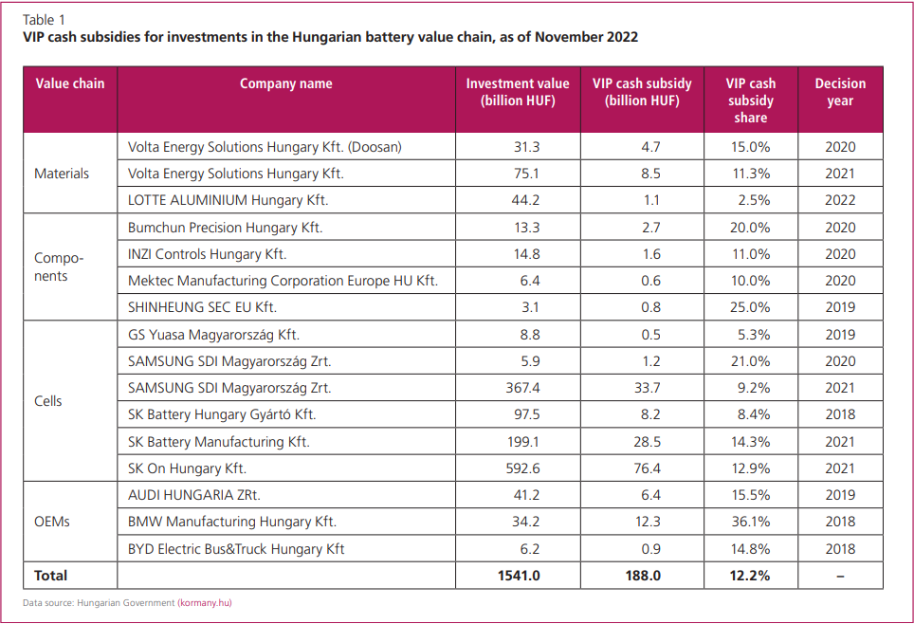

Slide 8
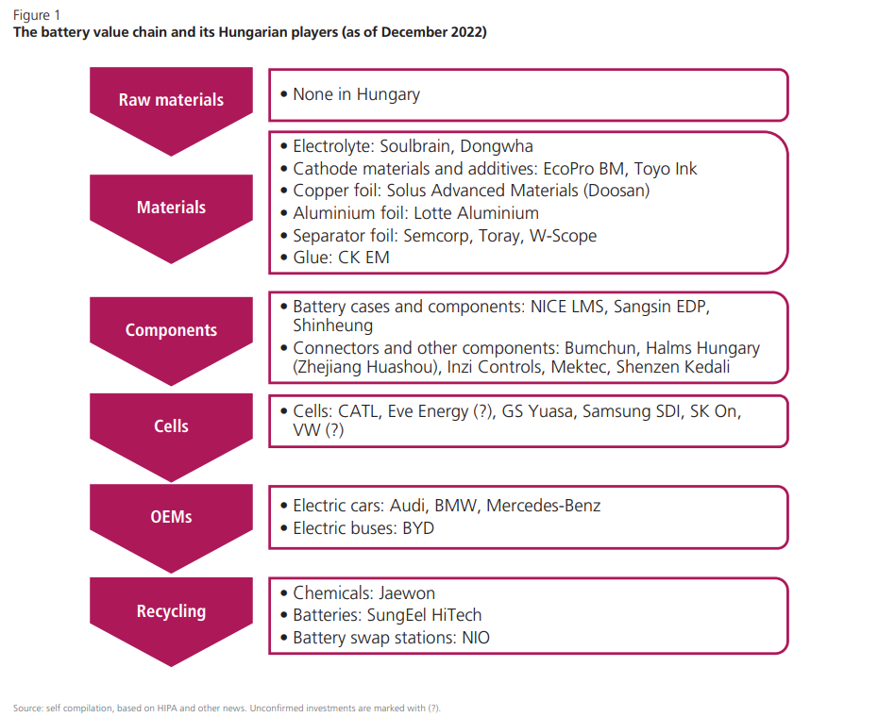

Slide 9
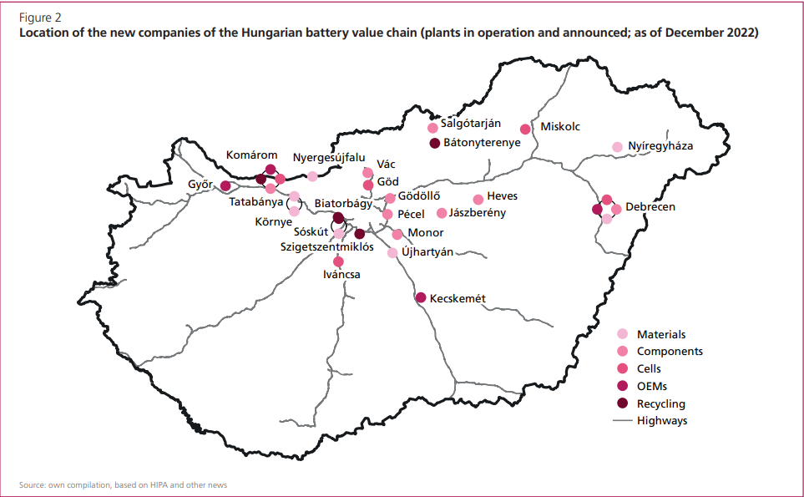

Slide 10
Electrification - Batteries
More than 20 factories / ongoing investments: SK Innovation/Battery, Semcorp, CATL, Samsung, LG, Jabil
Huge state support for new investments
Estimatation: by 2025 third in battery production capacity, and 30.000 workplaces
On country level currently 2% of the workforce is foreigner
In battery production is likely much higher (Ukranians, Serbians, lately from Asia: Mongolia, Philippenes, Vietnam, China, South-Korea)

Slide 11
Electrification – working conditions
Labor shortage – especially in skilled workers
Huge problems in the future
Labour intensive work
Blue and white collars
Comparing to an avarege automotive company, the share of white collars is smaller
Their role is smaller: no influene on the production process
Among blue collars unskilled workers is the biggest group
High fluctuation despite the relatively good wages (extra hours are paid well, high bonuses)
Because of the working conditions, especially compared to ICE

Slide 12
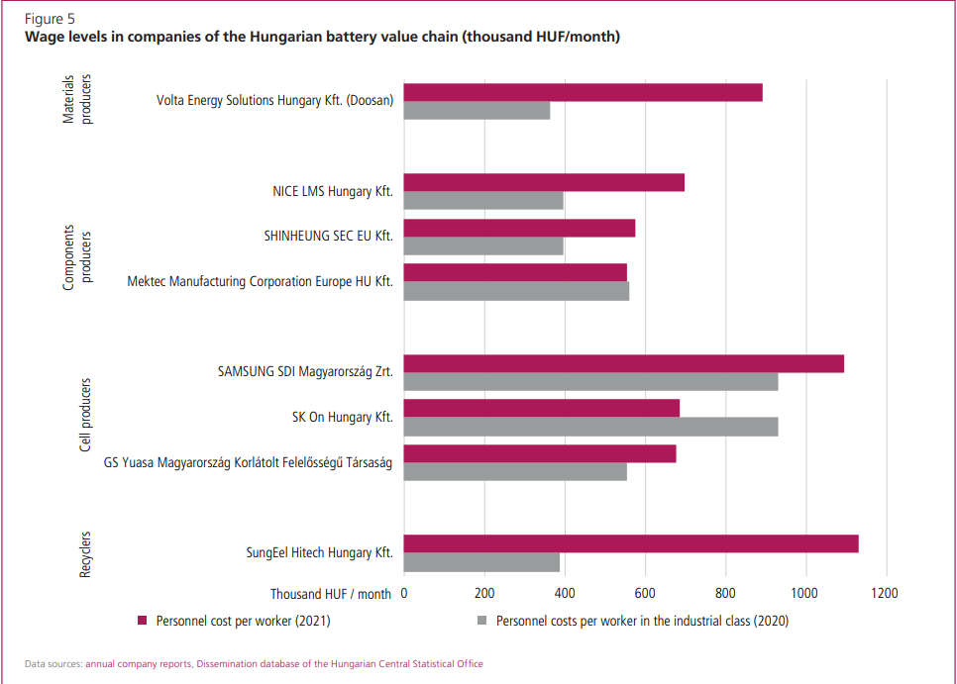

Slide 13
Electrification – working conditions
Environmental issues
Polluting water, soil, noise
OHS issues
Ventilation problems
Example: Hospitalization of 14 workers
Bad, old occupational safety equipments
Dangerous materials are not kept well
Rewriting the rules
Hostility toward unions
Cultural differences, local know how is not respected
Government doesn’t take these concerns seriously or as important

Slide 14
Hydrogen strategy
Main aims - 2030
Production of large quantities of low-carbon and decentralized carbon-free hydrogen;
Decarbonisation of industrial consumption, partly with hydrogen;
Green shipping;
Electricity and (natural) gas supporting infrastructure.

Slide 15
Production of hydrogen
2030 Annual 36,000 tons, of which 20,000 blue and 16,000 green hydrogen
Currently, only gray hydrogen, i.e. hydrogen with a high carbon footprint, is produced
Decentralized instead of centralized production (electrolysis)

Slide 16
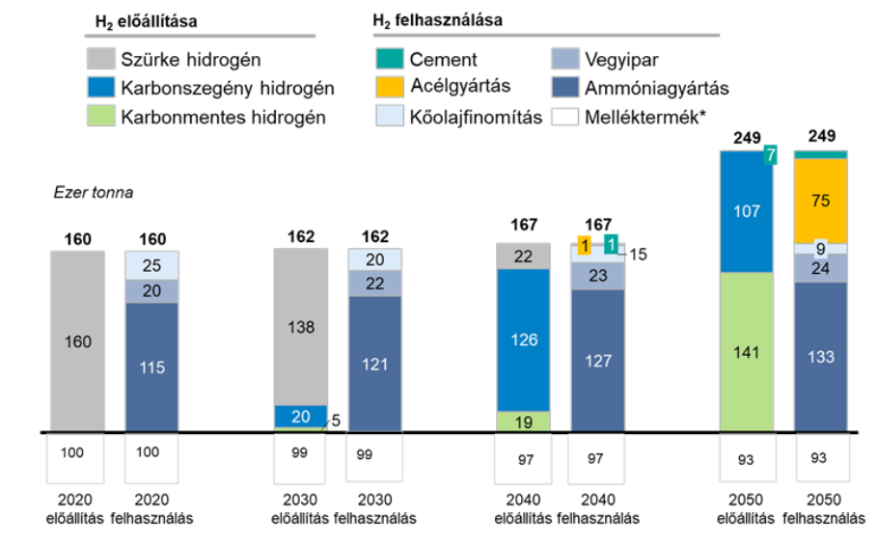
Industrial decarbonization
Two hydrogen valleys
Transdanubian hydrogen ecosystem
Production (e.g. Százhalombatta), energy for production (Paks) and use (e.g. Dunaferr, Beremend)
Northeast Hydrogen Valley (strong chemical industry, petrochemicals)

Slide 17
Greening for transport
The goal of the strategy is to help achieve carbon neutrality
Hydrogen in heavy vehicle traffic
Planned demand:
2030 - 10 thousand tons per year
2040 – 40 thousand
2050 – 130 thousand
Charging network - 20 stations by 2030

Slide 18
Supporting electricity and natural gas infrastructure
Goal: an infrastructure that supports the ability to store seasonal electricity
Construction of power-to-gas plants
Use of natural gas infrastructure in hydrogen transport

Slide 19
Thank you!

