Slide 1
Current Information OS KOVO
Vienna Memorandum Preparatory Meeting
7th November 2023

Slide 2
Political Situation
Four fundamental topics of the past period:
Consolidation package (Act amending certain laws in connection with the consolidation of public finances, parliamentary press 488) – The Chamber of Deputies approved the bill with the changes proposed by the Government, the legislative process in the Senate will begin on November 8, approval is likely
Pensions - part of the pension amendment has already been approved, the Government is preparing other proposals, including earlier retirements for demanding professions
Minimum wage (see below for details) – should be decided by mid-November
Energy prices (POZE - Supported energy sources)

Slide 3
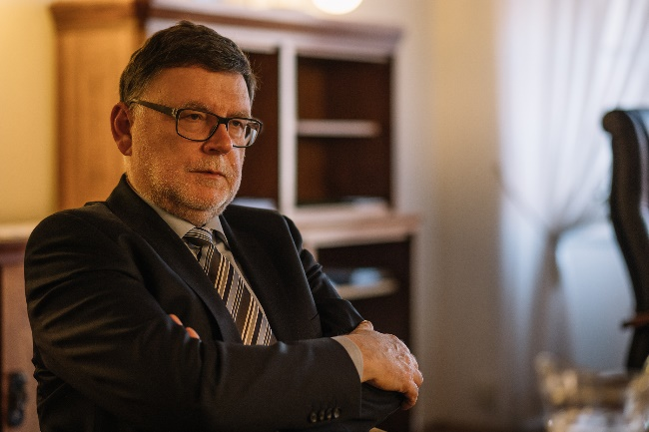
Political Situation
Consolidation Package – selected changes
The introduction of an annual limit for the tax exemption of benefits at ½ of the average salary
Reintroduction of the levy on sickness insurance for employees (0.6% of the assessment base ≈ gross wages)
Limitation of tax credit for spouse without income
Cancellation of tax exemptions (tuition fees, student discount, deduction of union contributions)
Changes in VAT rates, item transfers (increase in the price of some basic goods)
Increase in corporate income tax rate by 2% (from 19 to 21%)
Increase in real estate tax by an average of 1.8 times
Increase in excise duty on alcohol
Increase in the price of highway tolls
Increase in levies for the self-employed
The Government has succeeded in a miracle. It pissed off everyone throughout the pack.
Newspaper headline, Hospodářské noviny, 16.10.2023

Slide 4
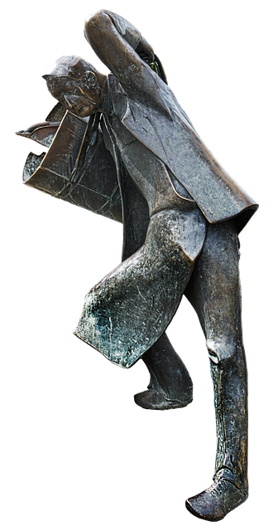
Political Situation
Pensions
The Government is preparing a reform that includes the extension of the pension age and other changes with a negative impact on future pensioners.
On the contrary, the Government, despite its promises (even contrary to the content of their Program Statement), still did not submit a proposal for earlier retirements for employees working in demanding professions.

Slide 5
Political Situation
The government's 2024 minimum wage proposal
 | Minimum wage | increase | Estimated share on average wage | Estimated share on average wage for 5 years
Option I | 18 900 CZK | 9,2% | 41,1 % | 45 %
Option II | 19 400 CZK | 12,1 % | 42,1 % | 50 %
The Government proposal is still considering maintaining 8 groups of guaranteed wages, it contains several variants of increases (percentage, fixed amounts, fixed amounts only to the 5th group, etc.)
ČMKOS Proposal
Employers´ Proposal
19 500 CZK
0 - 18 300 CZK

Slide 6
Political Situation
Energy prices
The State will no longer reimburse all costs associated with renewable energy sources next year. According to the Minister of Finance Zbyňek Stanjura (ODS), people and companies will once again start contributing to solar, water and wind power in their electricity bills. Until last autumn, it was CZK 600 (approx. 25 euros) for each megawatt hour for households. Then the Government paid the fee itself because of the sharp increase in price. Now energy prices are falling, which is why the cabinet is retreating from concessions.
Some parts of the Government's Consolidation Package reduce the competitiveness of Czech industrial companies, according to the president of the Union of Industry and Transport Jan Rafaj, the problem is in particular the significant increase in fees for renewable resources for energy-intensive companies. While Germany waives fees to companies for next year to encourage the slowing industry, and Slovakia lowers fees for energy-intensive operations for next year, Czech companies will pay more, Rafaj told ČTK today (10/10/2023) at the International Engineering Fair in Brno.

Slide 7
Political Situation
Numerous negotiations took place on these topics with coalition and opposition politicians, with employers and trade unions:

Slide 8
Political Situation
Protest actions took place:
Protest walk in Strakonice 20.6.2023
Demonstration 27.6.2023 in Ostrava

Slide 9
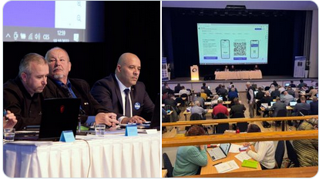
Political Situation
Meetings of Industrial Trade Unions of the Czech Republic
On October 3, 2023, representatives of industrial trade unions (miners, KOVO, Construction, food workers) met in Prague at the Olšanka Congress centre and established a platform defending the interests of workers in industry within the framework of ČMKOS – Industrial Alliance of Trade Unions (PAOS). Members demand a more vigorous approach in enforcing the rights of honest working people. The next meeting of PAOS took place on October 13 and 25.
On Wednesday 18.10. the OS KOVO Council met. It discussed the preparation of protest actions, the main topic of which will be:
Opposition to the Government's tax package
The return of payments for renewable resources to customer prices
Failure to address early retirement for demanding professions

Slide 10
Economics
GDP
Gross domestic product rose 0.1% quarter-on-quarter and fell 0.4% year-on-year in Q2.
Industry
Industrial production was 0.5% lower in real terms in the first half of 2023 compared to the second half of 2022. It grew by 1.2% year-on-year.
The production of motor vehicles contributed the most to the slight growth of industrial production.
The value of new orders at current prices in the 1st half of 2023 in the monitored sectors decreased by 0.3% year-on-year. New orders from abroad decreased by 3.4%. Domestic new orders increased by 6.3%.
The average registered number of employees in industry was 1.4% lower in the first half of 2023 than in the same period of the previous year and their average gross monthly nominal wage increased by 10.2%.
The decline continued in August as well - industrial production fell by 1.7% year-on-year, the value of new orders by 4.2%, the number of employees in industry fell by 2% year-on-year.

Slide 11
Economics
Forecasts of macroeconomic indicators
Indicator | Czech National Bank |  | Ministry of Finances
 | 2023 | 2024 | 2023 | 2024
GDP | 0,1 | 2,3 | -0,2 | 2,3
Inflation | 11,0 | 2,1 | 10,9 | 2,8
Unemployment | 2,7 | 2,8 | 2,8 | 2,7
Average real wage | -2,0 | 5,6 | -2,5 | 2,9
Labour productivity | -0,4 | 0,2 | -1,2 | 1,6
. As it follows from both forecasts, inflation will be high this year, and both institutions are optimistic about its taming next year.
According to both forecasts, the real wage should return to growth next year.
The European Bank for Reconstruction and Development has improved the Czech economy's outlook for this year. It now predicts that GDP will increase by 0.1 percent in the Czech Republic this year, while in May it predicted that it would decrease by 0.1 percent. However, the estimate of the growth of the Czech economy for next year worsened to 2.5 percent from the previously predicted 2.9 percent.

Slide 12
Economics
Unemployment in September 2023
The share of unemployed persons reached 3.6% in September, the same as in August (3.5% in July). As of September 30, 2023, there were a total of 263,020 unemployed people, and 281,995 job vacancies. 73,355 people received unemployment benefits, the average amount of which was CZK 10,672, i.e. EUR 434.
Uchazeči a volná pracovní místa
380 000
360 000
340 000
320 000
300 000
280 000
260 000
240 000
220 000
200 000
Uchazeči
Volná prac.místa

Slide 13
Economics
Inflation in September 2023
September 2023/September 2022 | 6,9
Annual rate | 12,7
In September, prices in the housing sector continued to have the greatest influence on the year-on-year growth in price levels, where apartment rents rose by 7.9%, water by 16.3%, sewage by 26.9% and heat and hot water by 36.2 %. Next in order prices in the food and non-alcoholic beverages section were the most influential, where potato prices increased by 63.4% and sugar by 44.6%. The prices of goods increased by 7.0% and the prices of services by 6.7%. The development of prices in the recreation and culture section was mainly influenced by higher prices of holidays with comprehensive services by 12.1%. In the catering and accommodation section, the prices of catering services increased by 10.1% and the prices of accommodation services by 12.2%.

Slide 14
Economics
Inflation forecasts for 2023 and 2024
Forecast author | Inflation 2023 2024
Czech National Bank | 11,0 | 2,1
Ministry of Finances | 10,9 | 2,8
Czech Bank Association | 11,0 | 2,7
European Commission | 11,9 | 3,4
OECD | 12,2 | 3,4
ČMKOS | 11,0 až 12,0 % | 4,5 až 5,5 %
Wage growth recommended by ČMKOS as a demand for CB 2024 – 8 to 10%

Slide 15
Economics
Average wage in Czech Republic
In the first half of 2023, the average wage reached 1,717 euros, an increase of 130 euros (8.2%) year-on-year.
Consumer prices increased by 13.7% during the mentioned period, so wages fell by 4.8% in real terms.
Development of nominal and real average wages
Source: Update information ČMKOS, 18.9.2023

Slide 16
Economics
Wages in metal industry for 1st half of 2023
Source: ČSÚ, unofficial results for OS KOVO needs only
Average wage KOVO (CZ-NACE 24 - 30)
1 823 eur
+ 9,5 % nominal wage
- 3,7 % real wage
24
25
26
27
28
29
30
Production of basic metals, metallurgical processing of metals; foundry
Manufacture of metal structures and metal products, except machinery and equipment
Manufacture of computers, electronic and optical instruments and equipment
Manufacture of electrical equipment
Manufacture of machinery and equipment n.e.c.
Manufacture of motor vehicles (except motorcycles), bodies, trailers and semi-trailers and parts and accessories
Production of other means of transport and equipment

Slide 17
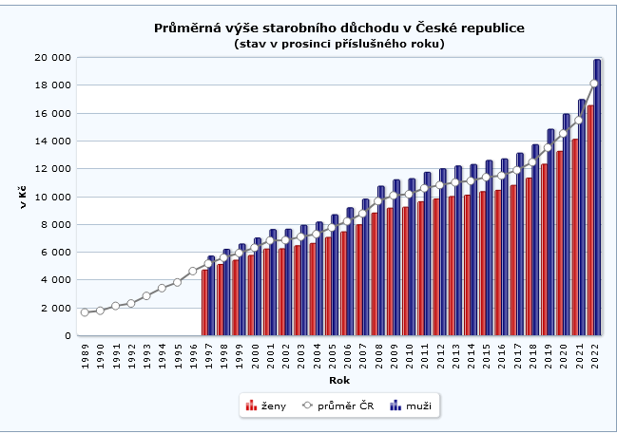
Economics
Pensions in Czech Republic
Average pension 2022 736 euro
Man 805 euro
Woman 671 euro
Woman/Man 83,4 %
Average pension 2023 (estimation) 822 eur (+ 11,7 %)
Share of pension on average wage:
Brutto 44,9 %
Netto 55,9 %
Development of the amount of pensions (total, men, women)

Slide 18
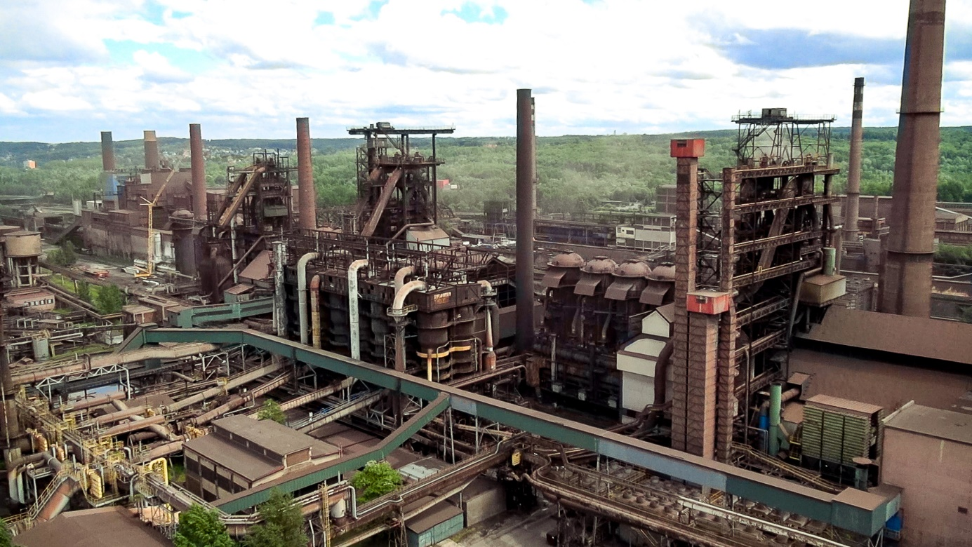
Company problems
In some companies of the metal industry, there are layoffs or production shutdowns - there is no demand.
There was also a partial reduction in production in car factories, BUT due to missing components - Škoda Auto, Toyota.
On the other hand, other companies are facing a labour shortage, they hire agency employees to an increased extent, in some companies the share of agency employees reaches over 40%.
The Liberty Ostrava steelworks is getting into more and more problems - the last blast furnace was temporarily (?) closed. The company suffers from a lack of funds, the management promises a quick solution, but the trade unionists are worried about jobs.

Slide 19
Trade Union Policy
OS KOVO Membership Development (without pensioners) in 2018 till 2022
Between 2018 and 2022, the number of KOVO members decreased by 17.2%.
Union organization in companies where OS KOVO operates fell from 23.6 to 21.9% (- 7.2%).
The share of women in the membership base of OS KOVO is about 25%.
In the period from June 30, 2022 to the end of September 2023, a total of 22 new Groupings of members and 3 new Company Organizations were created, in total 25 new organizational units.

Slide 20
Trade Union Policy
Recruiting new members
Promotion of CB results (+ supportin CB so that the results are good) – Intranet, Kovák (example Nexen and influence on CB in other companies)
Direct impact on members - training of officials
Benefit programs
Events in the regions (children's days,...)
Contests to gain the largest number of members, the highest percentage increase in membership in the organization
Activities of the Youth Commission
Involvement in the industriAll Europe Project (coll. Valeš = professional organizer)
A handbook of examples of good union practice is being prepared in cooperation with regional workplaces
Fight against the current anti-social Government (inflation, energy prices, austerity package,…) → increase in trust in trade unions by 10% (March 2023/March 2022)

Slide 21
THANK YOU FOR YOUR ATTENTION.

